Slide 1
Western TTAP Steering Committee Meeting
September 11th, 2024

Slide 2
ICE BREAKER
Name
Agency/Tribe
What is one song or artist that you’re embarrassed to admit you like?”

Slide 3
Agenda
Group introduction
Review Agenda
WTTAP
  Role
  Meet your staff!
  Meeting Structure
Workplan and Assessment Q’s
Q & A
Adjourn

Slide 4
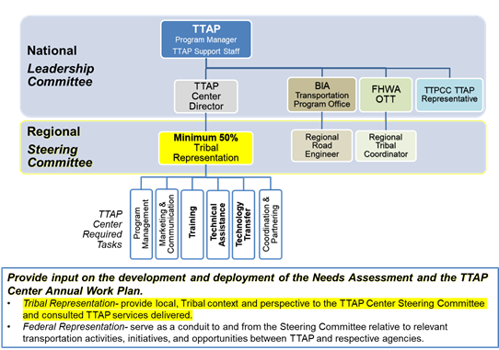
TTAP

Slide 5
Role
TTAP Vision
TTAP Mission
Through mutual respect and understanding, enhance the quality of life in Tribal communities by building capacity for Tribes to administer and manage their transportation programs and systems.
Serve as a go-to local resource for Tribal transportation training, technical assistance, and technology transfer needs and opportunities to effectively carry out the TTAP Vision.
Source:
https://www.fhwa.dot.gov/clas/ttap/background.aspx

Slide 6
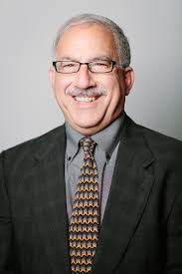
Meet your WTTAP staff!
David Peshkin (Principal In Charge)
Carrie Brown (Director)
Afsaneh Yavari (Technical Coordinator)
Tyler Reeb (Technical Coordinator)

Slide 7
Meet your WTTAP staff!
Nicole Slaboch (Instructional System Designer)
Monte Yazzie (SME)
Walita Querta (Graphic Artist)
Laura Melendy (Technical Advisor)

Slide 8
Meet your WTTAP staff!
Greg Duncan (Training Faculty)
Jeremy Birkey (Technical Transfer Coordinator/Instructional Technologist)
Luis Sibaja
(Technical Assistance Support)
April Marshall
(Program Coordinator)

Slide 9


Meet your WTTAP staff!
RoseMary Evans (508 Compliance Officer)
Tracey Smith (Training Coordinator)
Cayden Bergschneider (Graphic Designer)

Slide 10
Meeting Structure
Membership
Role/Relationship with TTAP
Frequency
Duration
Mission
Charter
Misc.

Slide 11
Items for Review
Workplan
Assessment Questions
FFY 24-25
Core Deliverable
Proposed work
Core Deliverable
Biennial
Guide proposed work

Slide 12

Questions?

Slide 13
Thank you!
Carrie Brown
cbrown@appliedpavement.com
775-432-4438

