Slide 1
Western TTAP
North Coast Tribal Transportation Commission
October 7th, 2024

Slide 2
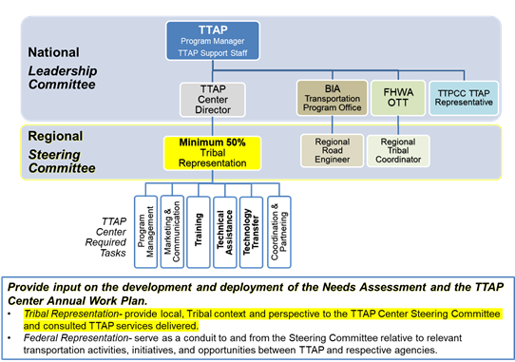
TTAP

Slide 3
Role
TTAP Vision
TTAP Mission
Through mutual respect and understanding, enhance the quality of life in Tribal communities by building capacity for Tribes to administer and manage their transportation programs and systems.
Serve as a go-to local resource for Tribal transportation training, technical assistance, and technology transfer needs and opportunities to effectively carry out the TTAP Vision.
Source:
https://www.fhwa.dot.gov/clas/ttap/background.aspx

Slide 4
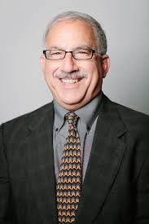
Meet your WTTAP staff!
David Peshkin (Principal In Charge)
Carrie Brown (Director)
Afsaneh Yavari (Technical Coordinator)
Tyler Reeb (Technical Coordinator)

Slide 5
Meet your WTTAP staff!
Nicole Slaboch (Instructional System Designer)
Monte Yazzie (SME)
Walita Querta (Graphic Artist)
Laura Melendy (Technical Advisor)

Slide 6
Meet your WTTAP staff!
Greg Duncan (Training Faculty)
Jeremy Birkey (Technical Transfer Coordinator/Instructional Technologist)
Luis Sibaja
(Technical Assistance Support)
April Marshall
(Program Coordinator)

Slide 7


Meet your WTTAP staff!
RoseMary Evans (508 Compliance Officer)
Tracey Smith (Training Coordinator)
Cayden Bergschneider (Graphic Designer)

Slide 8
Timeline – Activities to date
January 31st
Submitted TTAP Proposal
April 26th Notified of Award
May 6th Cooperative Agreement Executed
June 13th
Contracted SME and Graphic Artist
September 12th
1st Steering Committee Meeting
September 2024
Presented at NTICC
September 20th
Executed Web Development Contract
May 9th
Kick-off Meeting with FHWA
July 2024
Presented at NLTAPA
September 25th
CPS Training in Phoenix

Slide 9
Next Steps
Workplan
Biennial Needs Assessment
Representation at NLTAPA Executive Committee Meeting
Web Development
Subconsultant Contracts with UC Berkley and CSU Long Beach

Slide 10

Questions?

Slide 11
Thank you!
Carrie Brown
cbrown@appliedpavement.com
775-432-4438

