Slide 1
2023-2026 Accelerated Innovation Deployment (AID) Demonstration Grants
Chenxi Liu
10/24/2024

Slide 2
Basic Information
Agency: USDOT FHWA
Contact: Fawn Thompson, innovation@dot.gov
Key Date (FY 25):
  Announcement Date: Feb. 25, 2025
  Notice of Intent Due: Apr. 15, 2025
  Application Due: May 27, 2025
  Anticipated Award: Aug. 29, 2025
Grant Size: 10-15 awards, $12.5M total (FY25)
Award: $100K - $1M Each
Cost Share: 80% Federal, 20% Non-federal

Slide 3
Eligibility
State DOT: one application for DOT administered project
State DOT with LPA: two applications
Tribal Government: One application
FLMA: One application

Slide 4
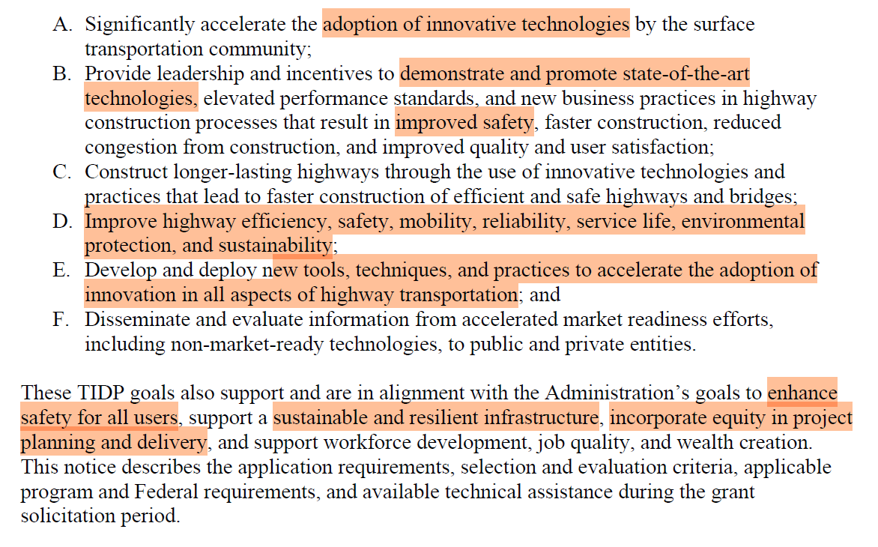
Project Objectives
More details can be found on NOFO Page 7

Slide 5
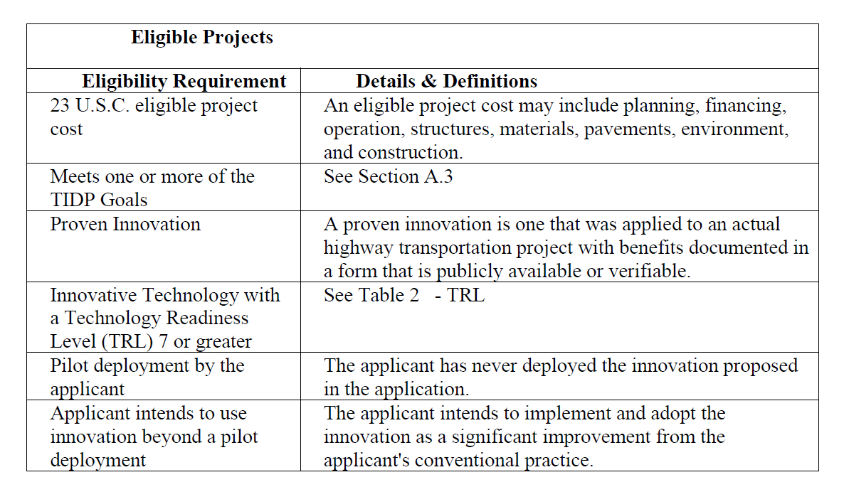
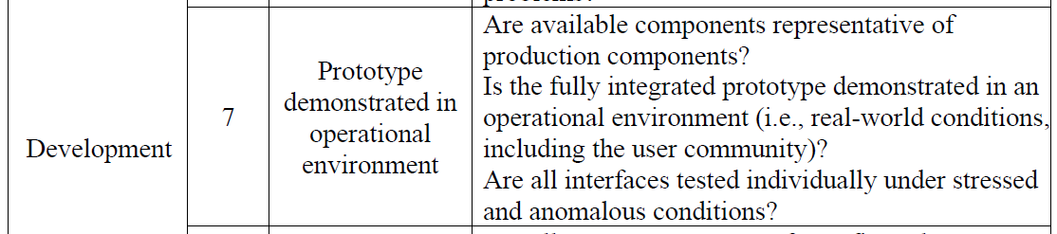
Eligible Project
An eligible project must be a pilot deployment by the applicant of a proven innovative practice or technology previously deployed by other transportation agencies and that the applicant intends to implement and adopt as a significant improvement from the applicant's conventional practice.

Slide 6
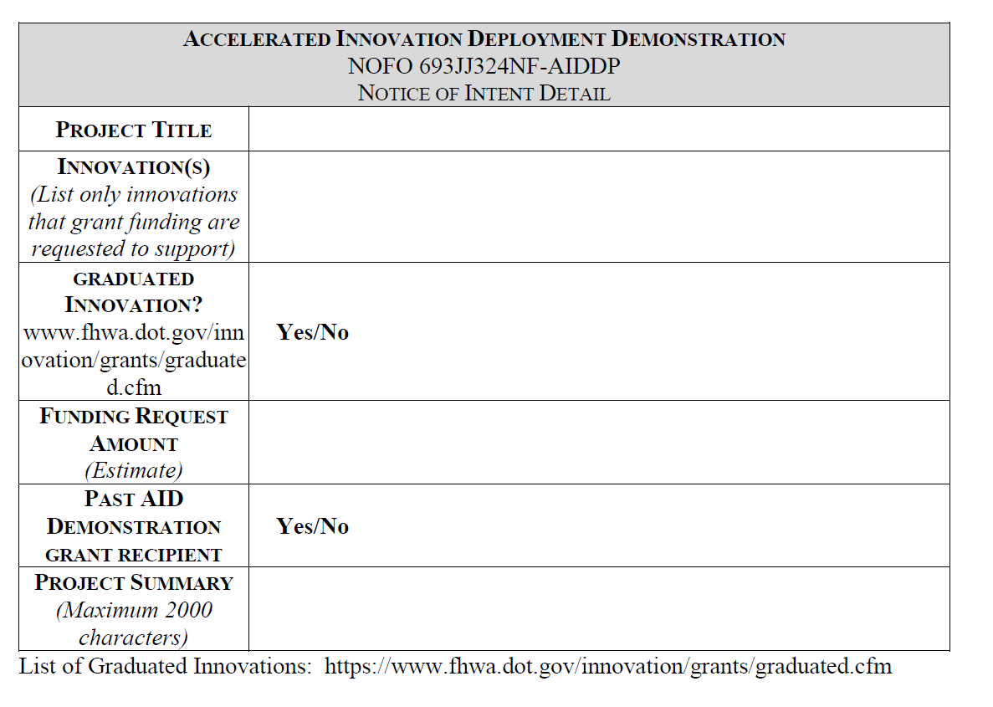
Submission Details
Notice of Intent

Slide 7
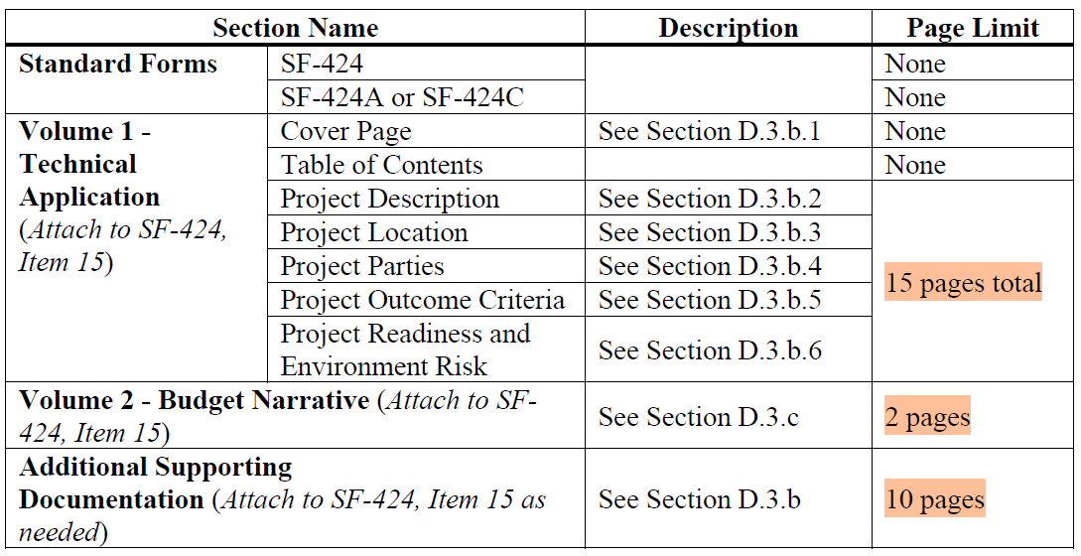
Submission Details
Application
Page 15-24

Slide 8
Useful Links
NOFO: https://www.grants.gov/search-results-detail/350699
AID FHWA: https://www.fhwa.dot.gov/innovation/grants/
Utah Indian Affairs: https://indian.utah.gov/

