Slide 1



Multi-task Sensing and Interaction System with Edge Artificial Intelligence
Chenxi (Dylan) Liu
Incoming Assistant Professor
Civil & Environmental Engineering
University of Utah, Salt Lake City
June 10, 2024
Contact Information
Email: chenxi.liu@utah.edu
Website: chenxiliu-dylan-github.io
University of Utah
Figure Sources: ChatGPT 4

Slide 2



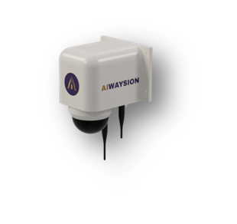












System Hardware Design
Hardware List
Camera (PTZ, Night Vision)
DHT22 (Environment)
Wi-Fi/Bluetooth Sensor
Communication Module (Cellular)
Edge computing unit (Jetson series)
Artificial Intelligence
MAC Address Detection
Computer Vision
Environmental Sensing
Integrated Sensing
Edge Computing
Wireless Communication

Slide 3
AI Technologies
Edge AI Sensing Technologies
Object Detection
Object Tracking
Density Detection
Human Pose Detection
Road Surface Detection
Road Visibility Detection
Vehicle Sensing
VRU Sensing
Environment Sensing
Vehicle Detection
VRUs Detection
Road Surface Condition
Vehicle Classification
VRUs Classification
Road Visibility Measurement
Volume Counting
VRUs Counting
Speed Measurement
Trajectory Recording
Trajectory Recording

Slide 4
AI-based Data Collection and Applications
Roadway Environment Data Collection
Environmental Conditions
Image/Video Dehaze
Visibility Estimation
Road Surface Condition Classification
Traffic Safety Applications
Collision and near-miss events
Hazadous conditions (low visiblity, adverse weather conditions, etc.)
Dilemma zone
Stopped vehicle
Wrong way driving
Speeding
01
04
Traffic Status Data Collection
Vehicle Detection
13-bin Vehicle Classification
Directional Volume Counting
Travel Time Estimation
Speed Measurement
02
05
CAV Communication
Vehicle-to-Infrastructure (V2I) communication
Pedestrian-to-Infrastructure (P2I) communication
03
VRUs Data Collection
VRUs Detection
Crowd Counting
Classification
06
Curb and Parking Management
Parking events (i.e., vehicle type, location, duration, ingress/egress time)
Availability & occupancy

Slide 5
Demonstrations
01
02
Roadway Environment Perception
Image/Video Dehaze
Visibility Estimation
Road Surface Classification
Vehicle Detection and Classification
Environment-aware Vehicle Detection
De-biased Vehicle Classification
03
04
VRUs Detection and Classification
Detailed VRUs Classification
Crowds Counting and Perception
Object Tracking and Trajectory Prediction
Object Tracking for Traffic Volume and Speed
Object Trajectory Extraction and Mapping
Dilemma Zone Detection and Mitigation
Trajectory and Potential Conflicts Prediction

Slide 6
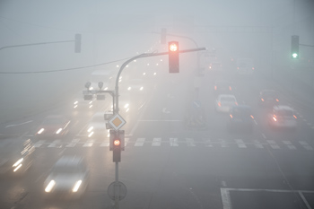
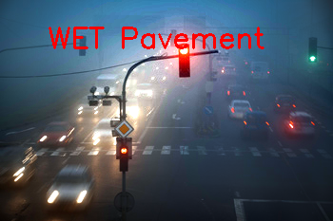
Demonstration 1: Roadway Environment Perception
Visibility: 0.58 mile
Before
After
The system can generate three products: 1) Dehazed Image; 2) Roadway Visibility; 3) Road Surface Condition
C. Liu, H. Yang, Z. Cui, R. Ke, and Y. Wang*. "Cooperative and Comprehensive Multi-task Surveillance Sensing and Interaction System Empowered by Edge Artificial Intelligence" in Transportation Research Record, 2023

Slide 7
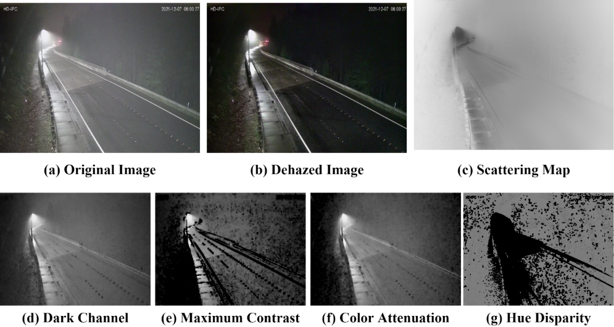
Demonstration 1: Roadway Environment Perception
Visibility: 0.58 mile

Slide 8
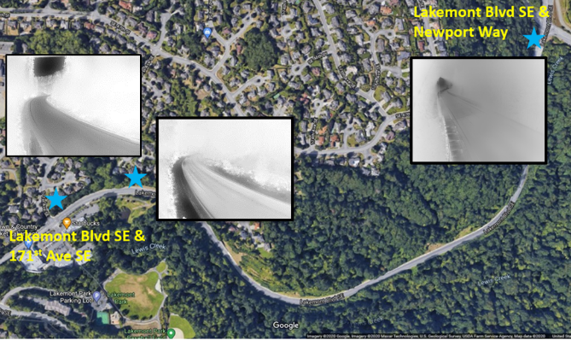
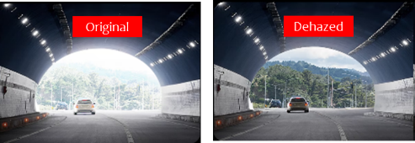
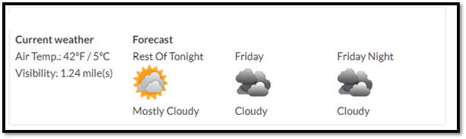
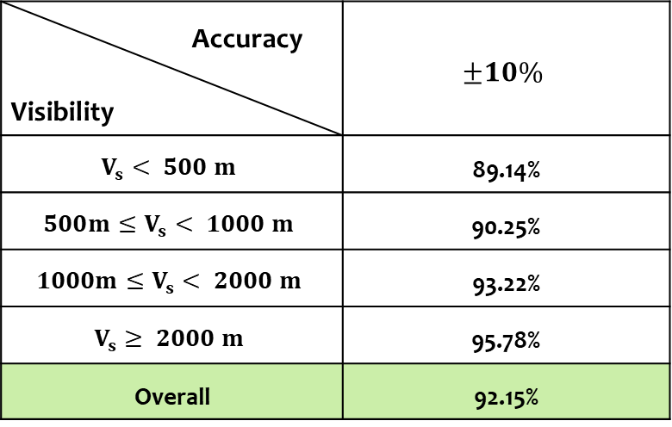
Demonstration 1: Roadway Environment Perception
Accuracy Visibility | $$±10\%$$
$$V_{s}< 500 m$$ | 89.14%
$$500m≤V_{s}< 1000 m$$ | 90.25%
$$1000m≤V_{s}< 2000 m$$ | 93.22%
$$V_{s}≥ 2000 m$$ | 95.78%
Overall | 92.15%
Weather Station

Slide 9
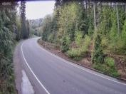
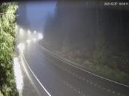
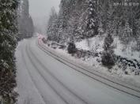
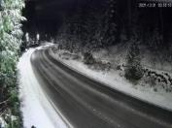
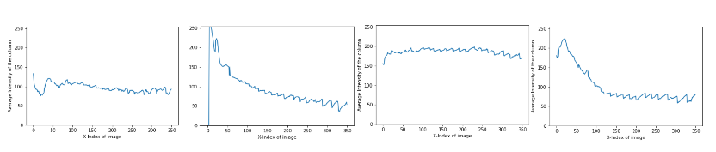
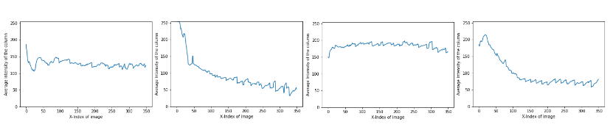
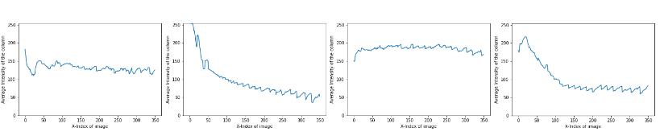
Demonstration 1: Roadway Environment Perception
Dry: 97%
Wet: 94%
Snowy: 91%
Icy: 85%
Original Image
Brightness
Dark Channel
Visibility: 0.58 mile
Intensity Value

Slide 10
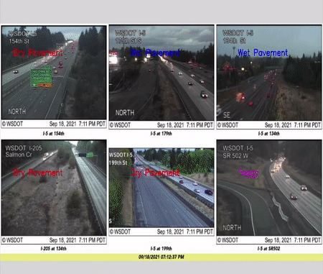
Demonstration 1: Roadway Environment Perception
Model | Accuracy |  |  |  |  | Mean
RF |  | Dry | Wet | Snowy | Icy | 95.25%
 | Dry | 0.97 | 0.01 | 0.02 | 0.00
 | Wet | 0.01 | 0.94 | 0.01 | 0.04
 | Snowy | 0.03 | 0.01 | 0.91 | 0.05
 | Icy | 0.01 | 0.09 | 0.05 | 0.85
KNN |  | Dry | Wet | Snowy | Icy | 83.65%
 | Dry | 0.92 | 0.02 | 0.05 | 0.01
 | Wet | 0.07 | 0.81 | 0.03 | 0.09
 | Snowy | 0.09 | 0 | 0.87 | 0.04
 | Icy | 0.04 | 0.19 | 0.10 | 0.67
SVM |  | Dry | Wet | Snow | Icy | 35.82%
 | Dry | 0.56 | 0.18 | 0.20 | 0.06
 | Wet | 0.21 | 0.34 | 0.19 | 0.26
 | Snow | 0.38 | 0.10 | 0.37 | 0.15
 | Icy | 0.09 | 0.36 | 0.22 | 0.33
NB |  | Dry | Wet | Snow | Icy | 66.36%
 | Dry | 0.86 | 0.03 | 0.10 | 0.01
 | Wet | 0.08 | 0.77 | 0.03 | 0.12
 | Snow | 0.12 | 0.02 | 0.79 | 0.07
 | Icy | 0.04 | 0.18 | 0.13 | 0.65
Visibility: 0.58 mile
Real-time road surface monitoring in Washington State

Slide 11
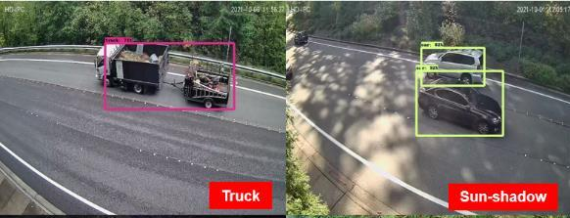
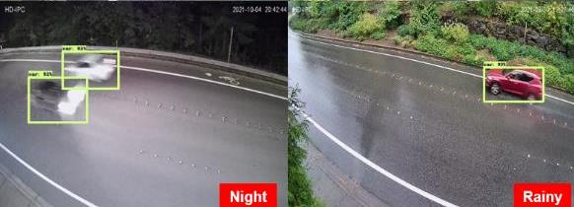
Demonstration 2: Vehicle Detection and Classification
[Environmental-aware Sensing Tech]: By Embedding the Environmental Information, the System can detect and classify objects in various weather and light conditions with high accuracy.
 | Car | Truck | Bus | Cyclist | Background
Car | 91% | 5% | 2% | 2% | 0
Truck | 6% | 87% | 4% | 3% | 0
Bus | 1% | 2% | 96% | 1% | 0
Cyclist | 2% | 2% | 1% | 95% | 0
Background | 0 | 0 | 0 | 0 | 100%

Slide 12
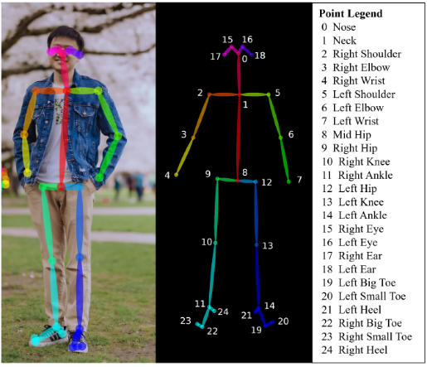
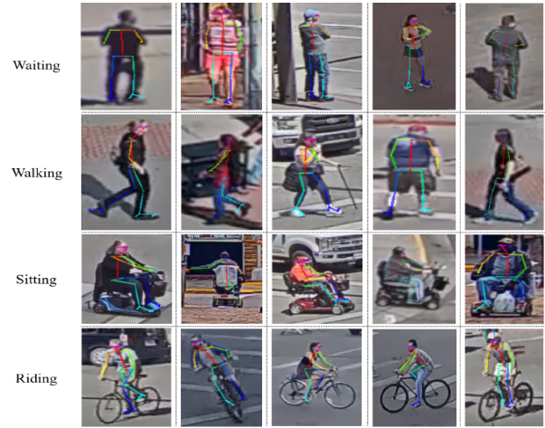
Demonstration 3: VRUs Detection and Classification
Waiting
Walking
Sitting
Riding
25-keypoints Pose Estimation (Openpose)
We then deployed the Human Pose Estimation Method for Detailed VRUs Classification

Slide 13
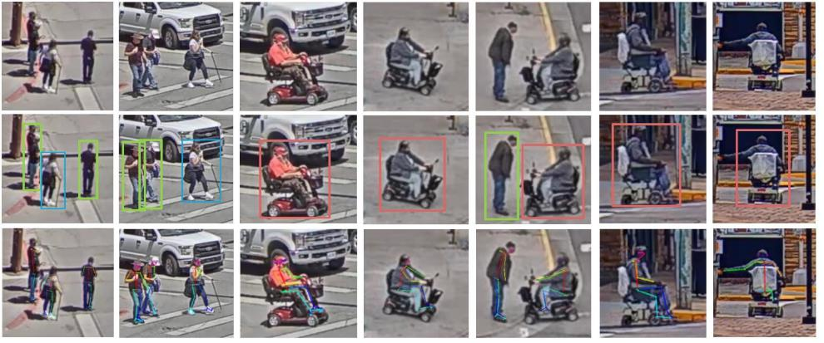

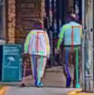
Demonstration 3: VRUs Detection and Classification
Original
Cropped Frames
Detection
&
Classification
25-keypoints Pose Estimation
Visualization of De-biased Vulnerable Road User Detection, Classification and 25-keypoints Pose Estimation
93.15% classification accuracy including six VRU types, including pedestrian, cyclist, four types of disabilities.

Slide 14
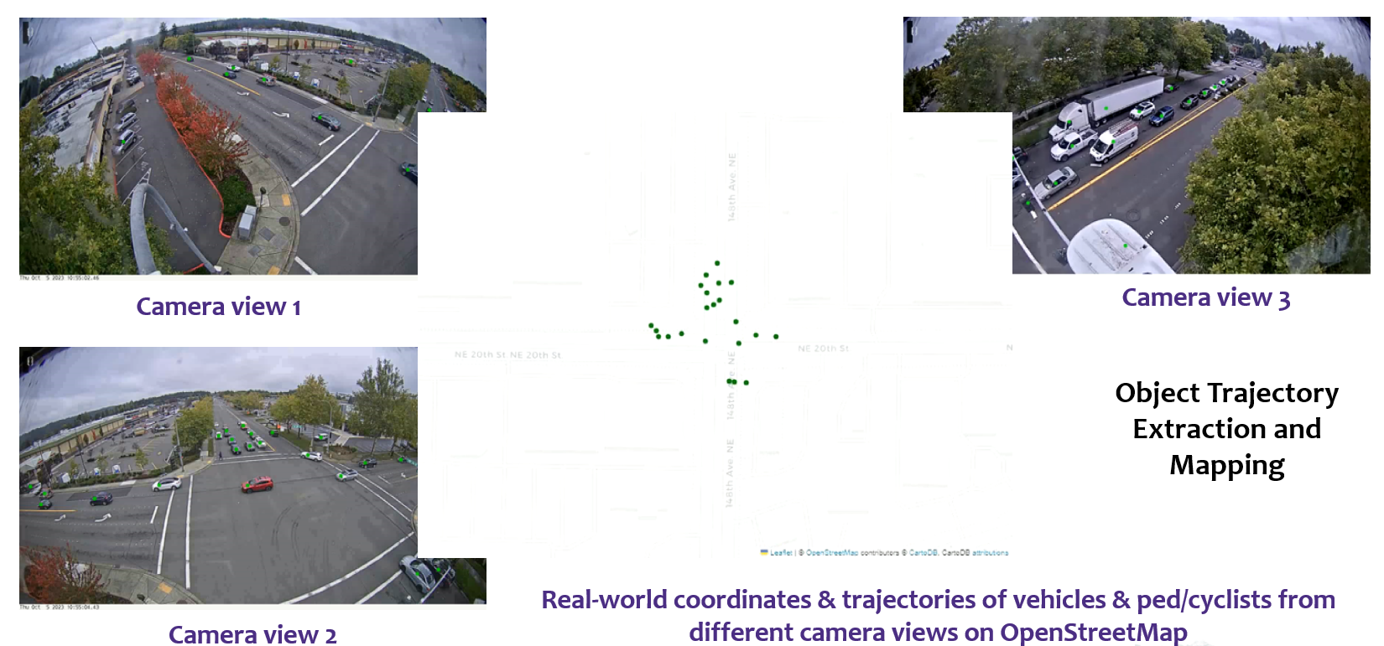
Demonstration 4: Objects Tracking & Trajectories Prediction

Slide 15
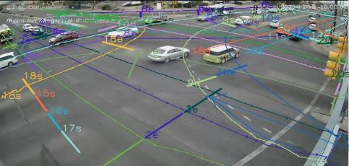
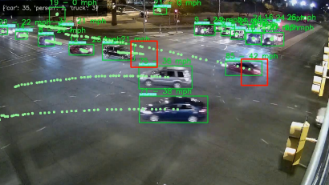
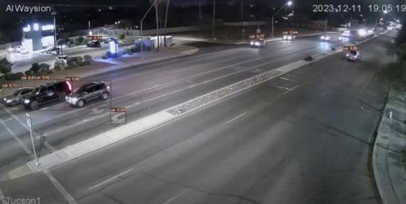
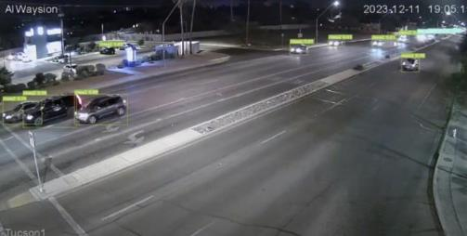
Demonstration 4: Objects Tracking & Trajectories Prediction
Potential Conflicts Prediction
Typical trajectory-based trajectory analysis, prediction & conflict events detection (TTC= 2s)
Others
Ours
Accurate detection in low-light conditions. (Tucson site, range= 600 ft)

Slide 16

Multi-task Sensing and Interaction System with Edge Artificial Intelligence
Chenxi (Dylan) Liu
Incoming Assistant Professor
Civil & Environmental Engineering
University of Utah, Salt Lake City
June 10, 2024
Contact Information
Email: chenxi.liu@utah.edu
Website: chenxiliu-dylan-github.io
University of Utah
Figure Sources: ChatGPT 4

